Slide 1

Chapter 7
Transmission Media
7.<number>
Copyright © The McGraw-Hill Companies, Inc. Permission required for reproduction or display.

Slide 2

Figure 7.1 Transmission medium and physical layer
7.<number>

Slide 3

Figure 7.2 Classes of transmission media
7.<number>

Slide 4
7-1 GUIDED MEDIA
Guided media, which are those that provide a conduit from one device to another, include twisted-pair cable, coaxial cable, and fiber-optic cable.
Topics discussed in this section:
Twisted-Pair Cable
Coaxial Cable
Fiber-Optic Cable
7.<number>

Slide 5
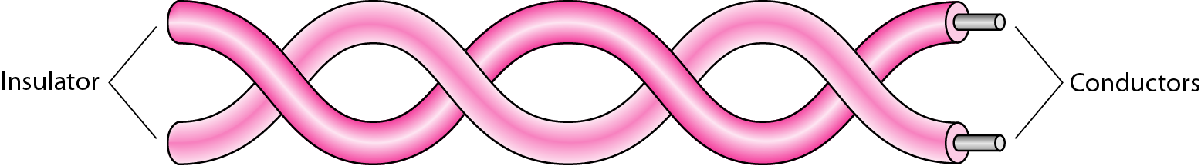
Figure 7.3 Twisted-pair cable
7.<number>

Slide 6

Figure 7.4 UTP and STP cables
7.<number>

Slide 7

Table 7.1 Categories of unshielded twisted-pair cables
7.<number>

Slide 8

Figure 7.5 UTP connector
7.<number>

Slide 9

Figure 7.6 UTP performance
7.<number>

Slide 10

Figure 7.7 Coaxial cable
7.<number>

Slide 11

Table 7.2 Categories of coaxial cables
7.<number>

Slide 12

Figure 7.8 BNC connectors
7.<number>

Slide 13

Figure 7.9 Coaxial cable performance
7.<number>

Slide 14

Figure 7.10 Bending of light ray
7.<number>

Slide 15

Figure 7.11 Optical fiber
7.<number>

Slide 16

Figure 7.12 Propagation modes
7.<number>

Slide 17

Figure 7.13 Modes
7.<number>

Slide 18

Table 7.3 Fiber types
7.<number>

Slide 19

Figure 7.14 Fiber construction
7.<number>

Slide 20

Figure 7.15 Fiber-optic cable connectors
7.<number>

Slide 21

Figure 7.16 Optical fiber performance
7.<number>

Slide 22
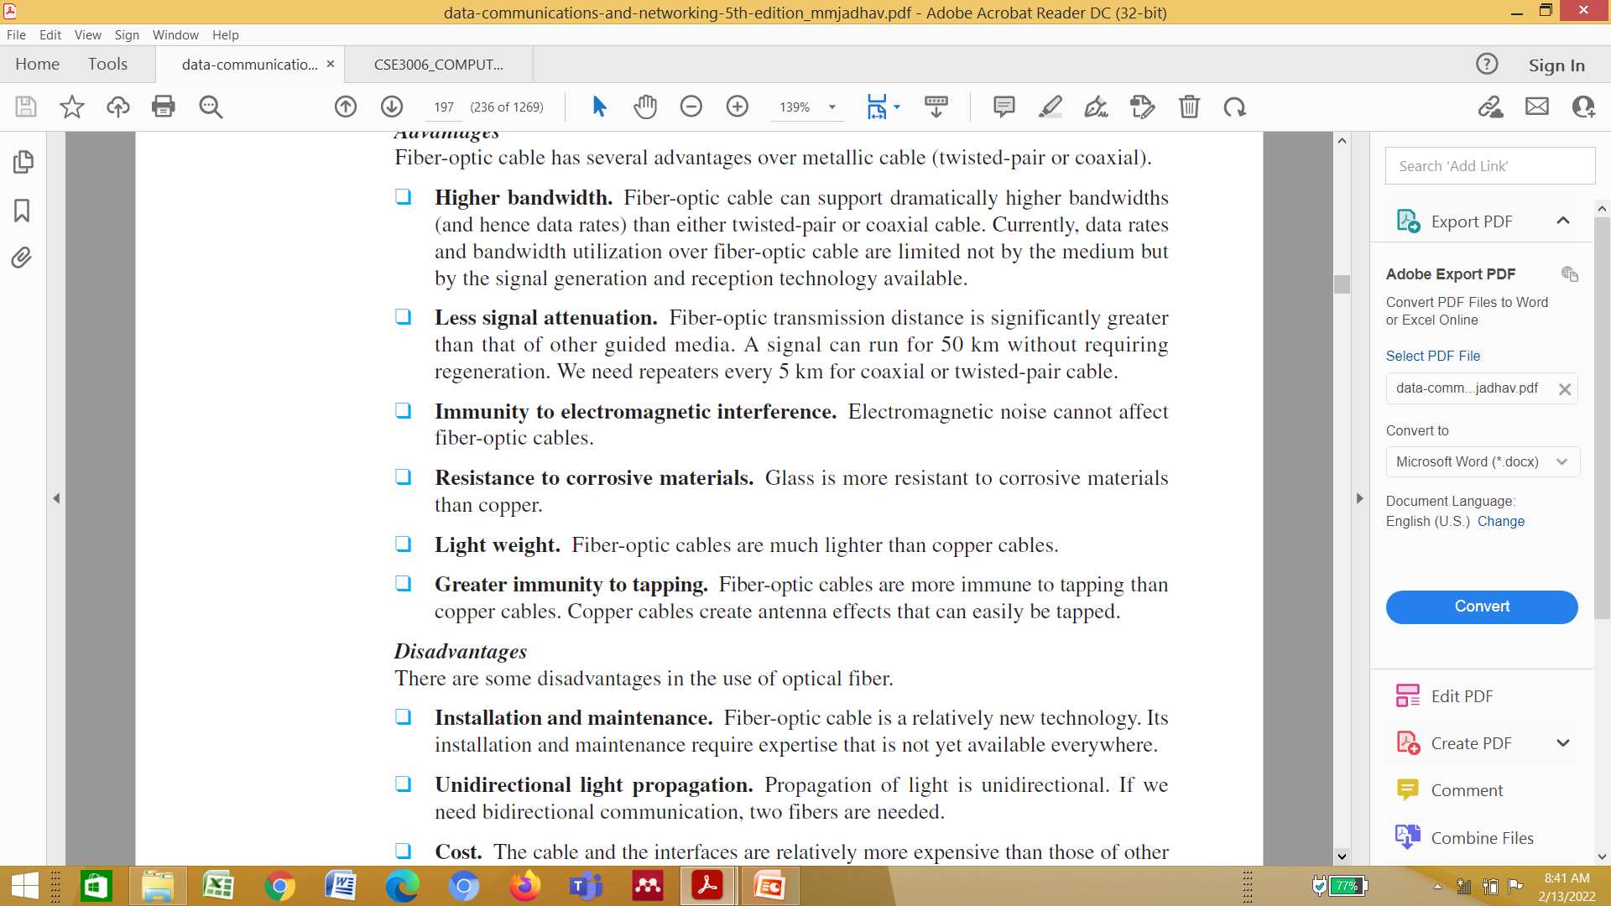
7.<number>

Slide 23
7-2 UNGUIDED MEDIA: WIRELESS
Unguided media transport electromagnetic waves without using a physical conductor. This type of communication is often referred to as wireless communication.
Topics discussed in this section:
Radio Waves
Microwaves
Infrared
7.<number>

Slide 24

Figure 7.17 Electromagnetic spectrum for wireless communication
7.<number>

Slide 25

Figure 7.18 Propagation methods
7.<number>

Slide 26
In ground propagation, radio waves travel through the lowest portion of the atmosphere, hugging the earth. These low-frequency signals emanate in all directions from the transmitting antenna and follow the curvature of the planet. Distance depends on the amount of power in the signal: The greater the power, the greater the distance
7.<number>

Slide 27
In sky propagation, higher-frequency radio waves radiate upward into the ionosphere (the layer of atmosphere where particles exist as ions) where they are reflected back to earth. This type of transmission allows for greater distances with lower output power
7.<number>

Slide 28
In line-of-sight propagation, very high-frequency signals are transmitted in straight lines directly from antenna to antenna. Antennas must be directional, facing each other, and either tall enough or close enough together not to be affected by the curvature of the earth. Line-of sight propagation is tricky because radio transmissions cannot be completely focused
7.<number>

Slide 29

Table 7.4 Bands
7.<number>

Slide 30

Figure 7.19 Wireless transmission waves
7.<number>

Slide 31
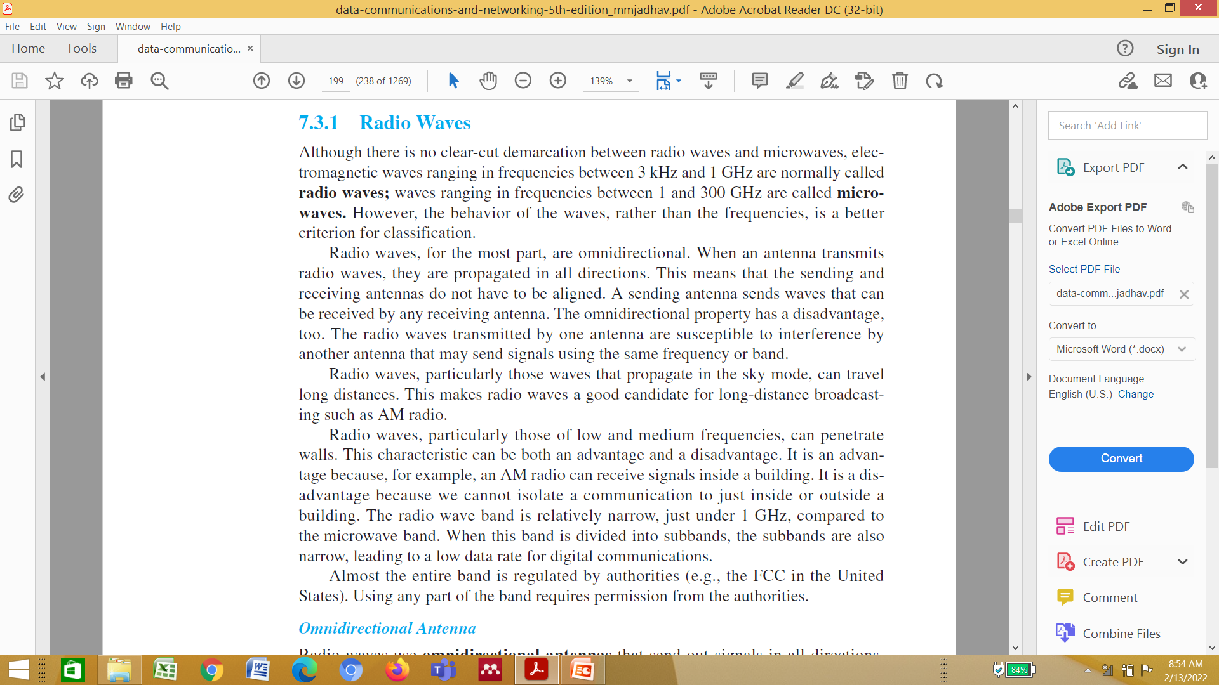
7.<number>

Slide 32

Figure 7.20 Omnidirectional antenna
7.<number>

Slide 33

Note
Radio waves are used for multicast communications, such as radio and television, and paging systems.
Applications
The omnidirectional characteristics of radio waves make them useful for multicasting,
in which there is one sender but many receivers. AM and FM radio, television, maritime
radio, cordless phones, and paging are examples of multicasting
7.<number>

Slide 34
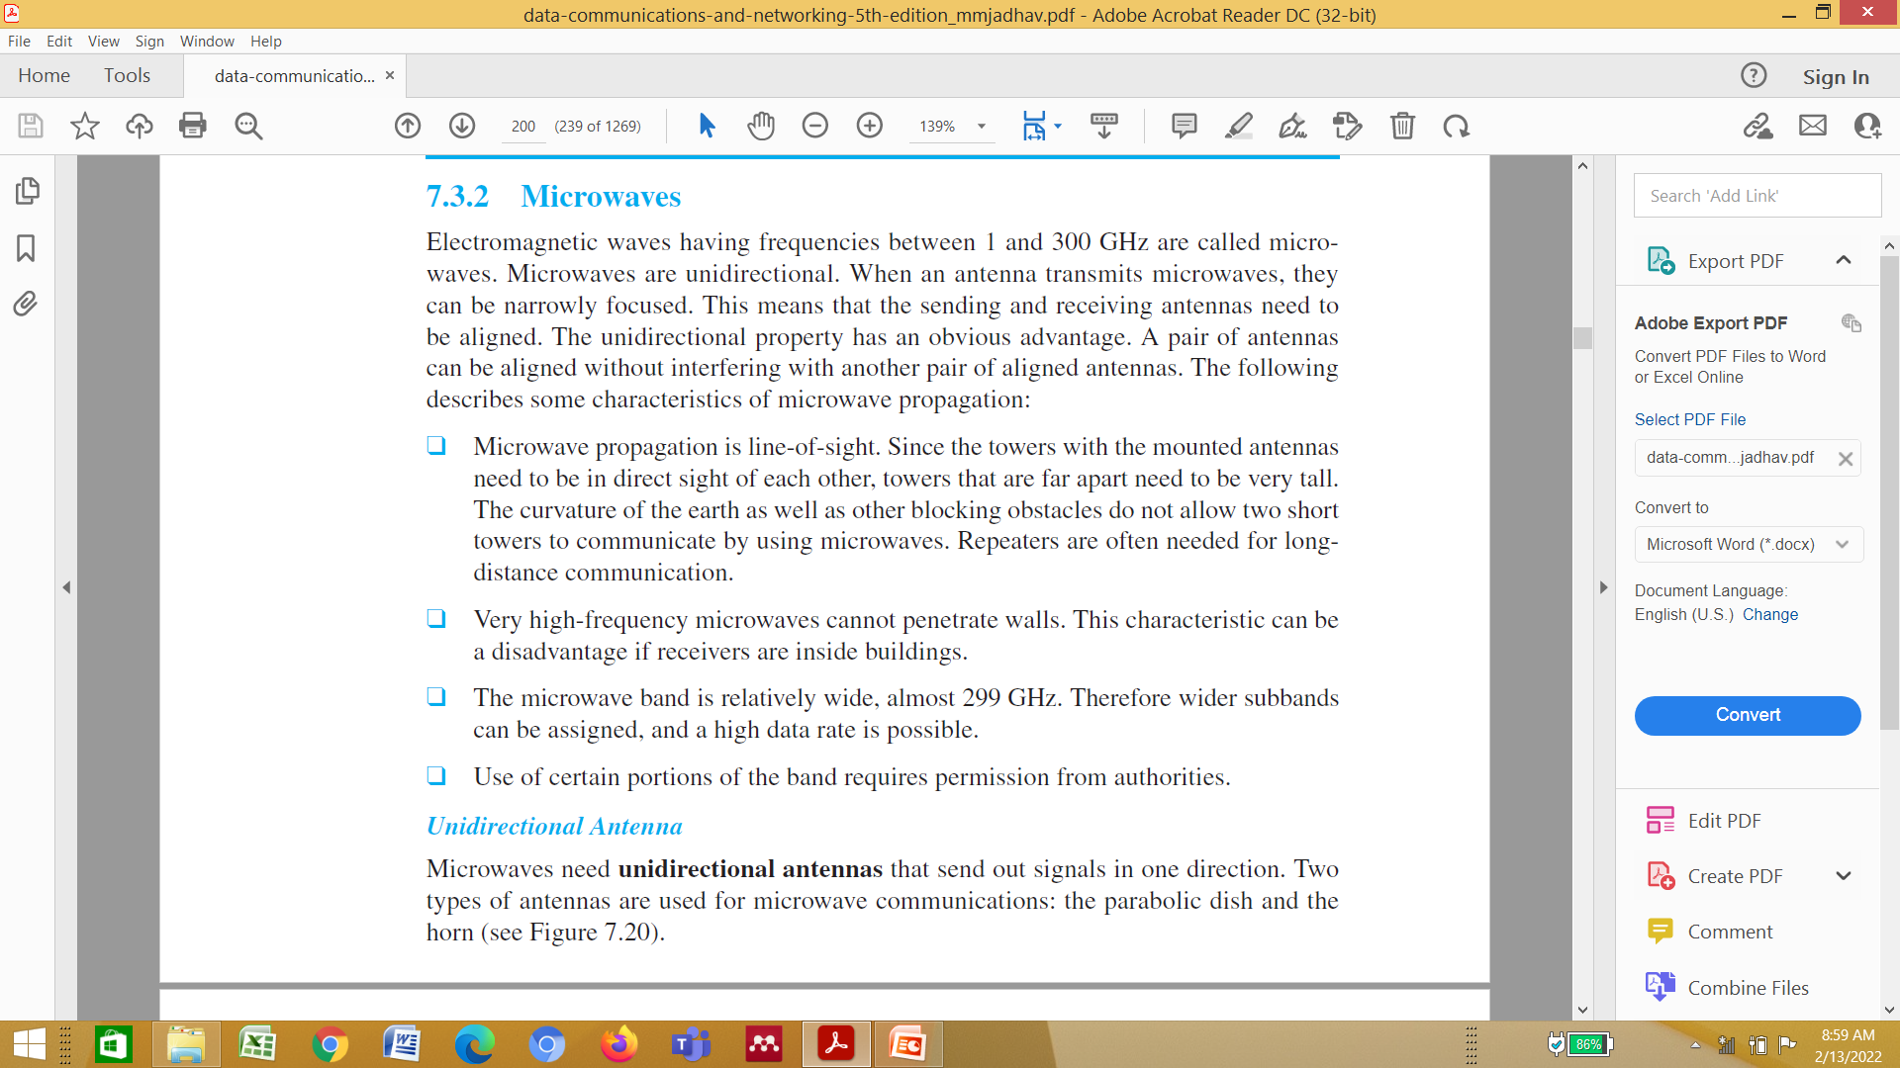
7.<number>

Slide 35

Figure 7.21 Unidirectional antennas
7.<number>

Slide 36
A parabolic dish antenna is based on the geometry of a parabola: Every line parallel to the line of symmetry (line of sight) reflects off the curve at angles such that all the lines intersect in a common point called the focus. The parabolic dish works as a funnel, catching a wide range of waves and directing them to a common point. In this way, more of the signal is recovered than would be possible with a single-point
Receiver.
7.<number>

Slide 37
A horn antenna looks like a gigantic scoop. Outgoing transmissions are broadcast up a stem (resembling a handle) and deflected outward in a series of narrow parallel beams by the curved head. Received transmissions are collected by the scooped shape of the horn, in a manner similar to the parabolic dish, and are deflected down into the stem
7.<number>

Slide 38
Note
Microwaves are used for unicast communication such as cellular telephones, satellite networks,
and wireless LANs.
7.<number>

Slide 39
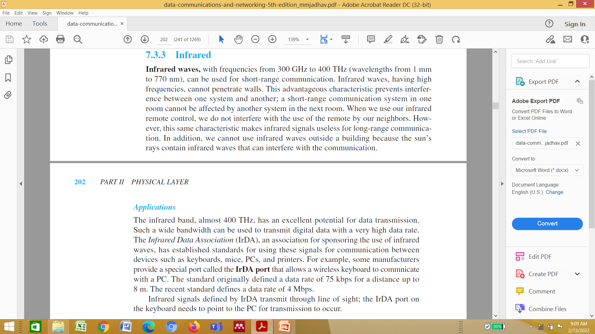
7.<number>

Slide 40
Note
Infrared signals can be used for short-range communication in a closed area using line-of-sight propagation.
7.<number>

